Slide 1
The National Institute of Engineering
Data Base Systems Project
Topic – NIE Achievers

Slide 2
Done by: 1) Arya AI
2)Abinav Kumar
3)Akshay Kamath

Slide 3
INTRODUCTION
Management of sports in NIE requires to keep a track of many different activities at different timelines. This becomes a major problem as and when the number of students interested in sports activities increases. Our project “NIE Sports Management” provides an efficient solution to this problem. Having a unified management system for all sports reduces the burden on the PD faculty of the institution and paves a way to manage the sports database.
Our project provides a user-friendly web interface to the students of the institution to register for the sports they are interested in, view the achievements of the institution in various events conducted throughout the academic year and get to know more about upcoming events.

Slide 4
Physical Department teacher gets the privilege to handle the student database, updating as and when the students are selected to represent the college team in a particular sport, whether or not to remove a student record, display the achievements of the college and the upcoming events.
Interested students can register directly in our website. A student who has already registered can access the website and see the required details about the sports activities using a unique USN given by the user at college admission time.

Slide 5
BACK END
A back end is nothing but a database which is used by users indirectly through an external application rather than by application programming store within the database itself. A back-end database stores data but doesn’t include end user applications.
For this project, we have used PHP to develop the back end .PHP is used to link all the tables created for this project to the webpage.
DATABASE MANAGEMENT SYSTEM
A database management system (DBMS) is a collection of programs that enables users to create and maintain a database. The DBMS is a general-purpose software system that facilitates the process of defining, constructing, manipulating and sharing databases among various users and applications.
A database is the process of storing the data on some storage medium that is controlled by the DBMS. Manipulating a database includes functions such as querying the database to update the database to reflect changes in the miniworld and generating reports from the data.
Some important functions provided by the DBMS include protecting the database and maintaining it over a long period of time. Protection includes system protection against software or hardware malfunction and security protection against unauthorized or malicious access. A typical large database may have a life cycle of many years, so the DBMS must be able to maintain the database system by allowing the system to evolve as requirements change over time. It is absolutely necessary to use general purpose DBMS software to implement a computerized database. We could write our own set of programs to create and maintain the database, in effect creating our own special-purpose DBMS software.
For our project, we have used MySQL which is the worlds most widely used open source relational database management system (RDBMS) that runs a server providing a multi-user access to a number of databases. The SQL phrase stands for Structured Query Language.

Slide 6
FRONT END
Front-end web development is the practice of converting data to a graphical interface, so that users can view and interact with that data. Everything that you see when you’re navigating around the Internet, from fonts and colors to dropdown menus and sliders is being controlled by your computer’s browser.
For our projects front end development, we have used HTML,CSS and Bootstrap.

Slide 7
SYSTEM ANALYSIS
During analysis, data collected on various files, decision points and transactions handled by the present system. The commonly used tools in the system are Data Flow-Diagrams, interviews, etc. training experience and common sense are required for collection of relevant information needed to develop the system. The success of the system depends largely on how clearly the problem is defined, thoroughly investigated and properly carried out through the choice of the solution.
A good analysis model should provide not only the mechanism of the problem understanding but also the framework of the solution. The proposed system should be analysed thoroughly in accordance with the needs

Slide 8
EXISTING AND SUPPORT SYSTEMS
The existing NIE website of the institution doesn’t comprise of a facility for student achievers management and there is no such existing system with the management department of the institution. Our main aim is to bring in a new add on that can provide the institution’s management department with a user-friendly interface and also reduce the burden of manual maintenance of student achievement details of each category separately .

Slide 9
b)PROPOSED SYSTEM
We provide a user interface website where the achievements of the students regarding their academic performance as well as cultural achievements can be stored register and accessed by the institution whenever required. The authorized user of the management department of the institution or faculty member gets the authority to access and updates through this system about the students and their respective achievements.Faculty members can access this data whenever they have to award the students for their achievements or update or add the achievements or delete any wrong data.
This way, we are reducing the cumbersome and time-consuming method of maintaining record of the student achievers and manual calculation of highest cgpa identification. We are also solving the problem of storing separate data for each field of achievement by storing all the categories in one database which reduces time and makes access of information easier.
The institutions management member or any authorized faculty member has the access of the webpage and has the powers to add/delete students to the various teams, add/modify/delete the details about the various events for which awards were received and the positions secured in them. He can also update the student database at the end of each academic year, deleting the students who have graduated and adding them to a database of all the alumni.

Slide 10
SOFTWARE AND HARDWARE REQUIREMENTS
Hardware:
1: A dual core CPU @ 2.5GHz
2: minimum of 256 MB ram
3: 20 GB of storage
4: Fast and high bandwidth internet connection
5: A router with port forwarding setup for the server

Slide 11
Software:
1: Web browser
2: xampp
3: MySQL
4: PHP
5: CSS
6: HTML
7: Bootstrap
8: Compatible version of Linux or Windows

Slide 12
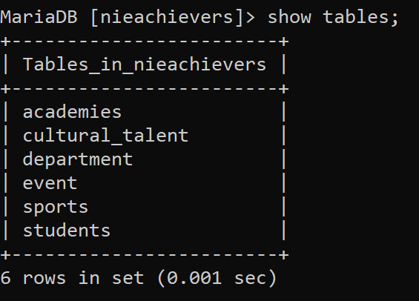
TABLES USED AND ER-DIAGRAM

Slide 13
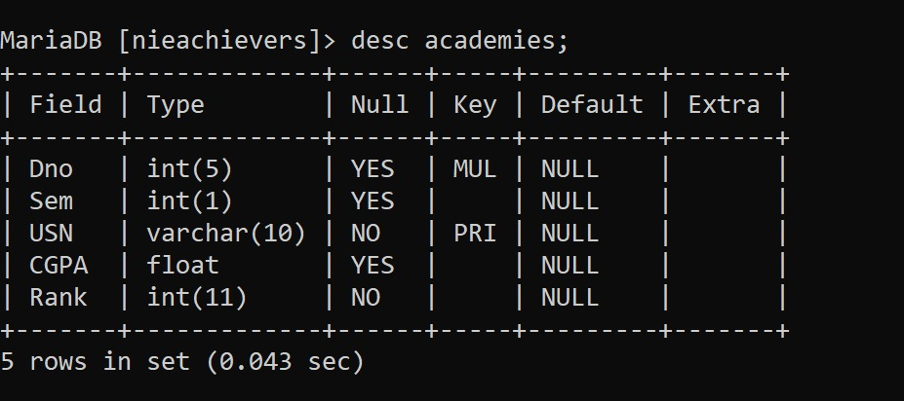

Slide 14
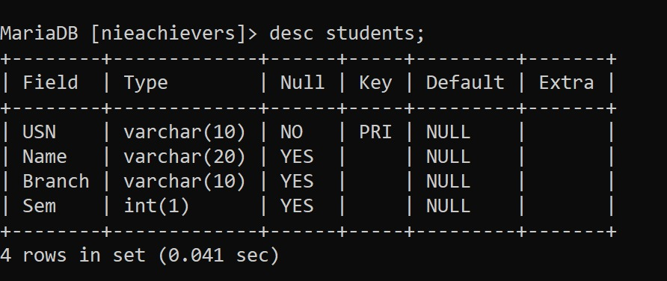
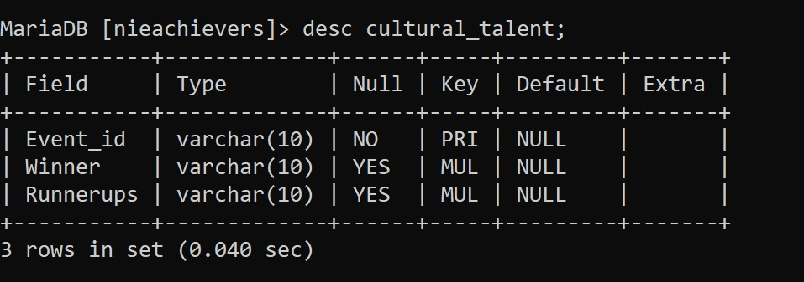

Slide 15
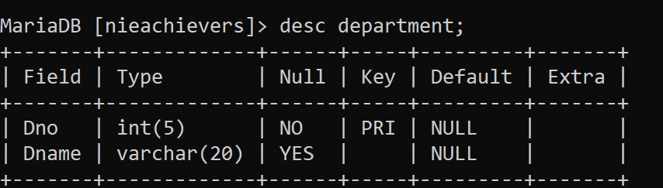
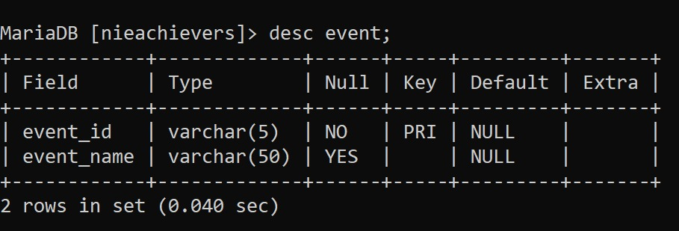

Slide 16
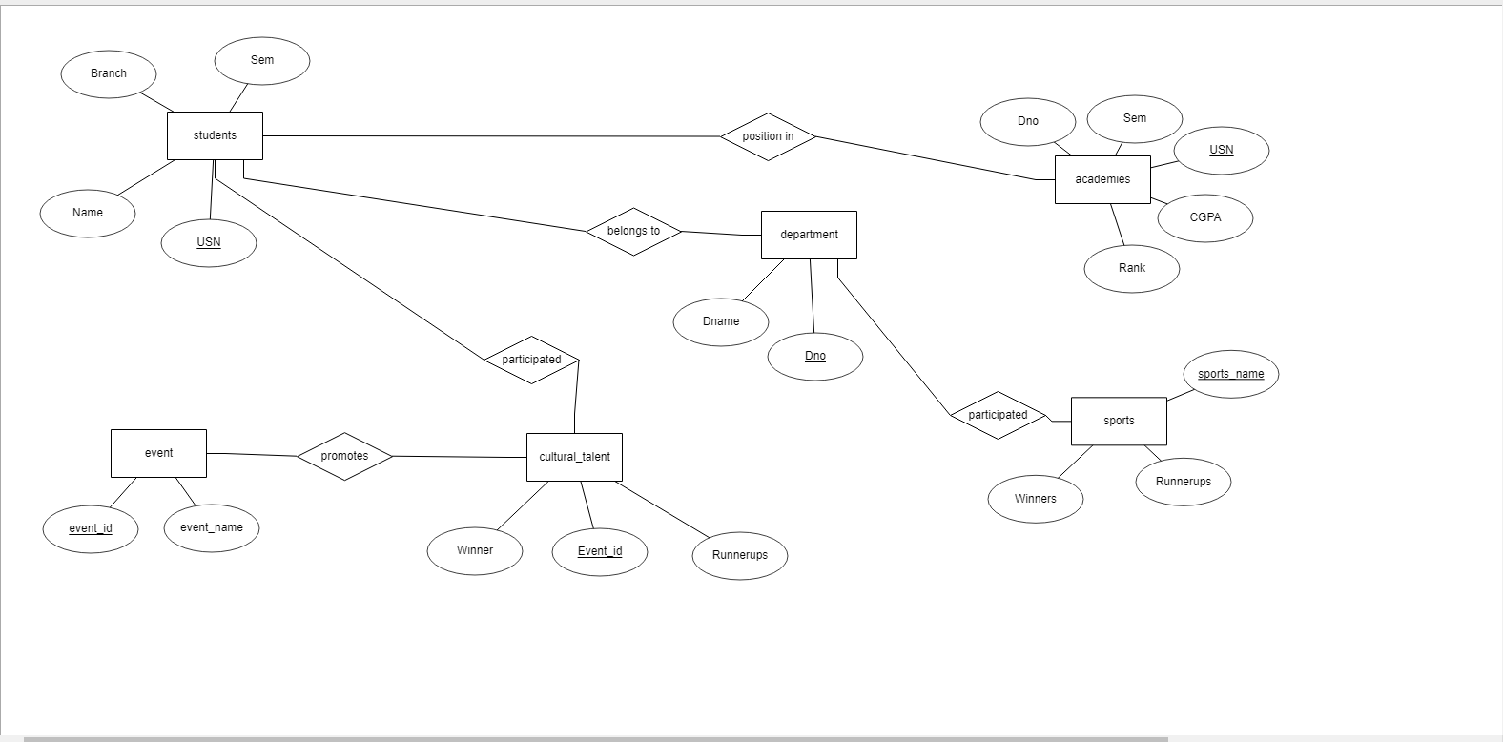
The ER diagram comprises of all the relationships between the tables and the attributes

Slide 17
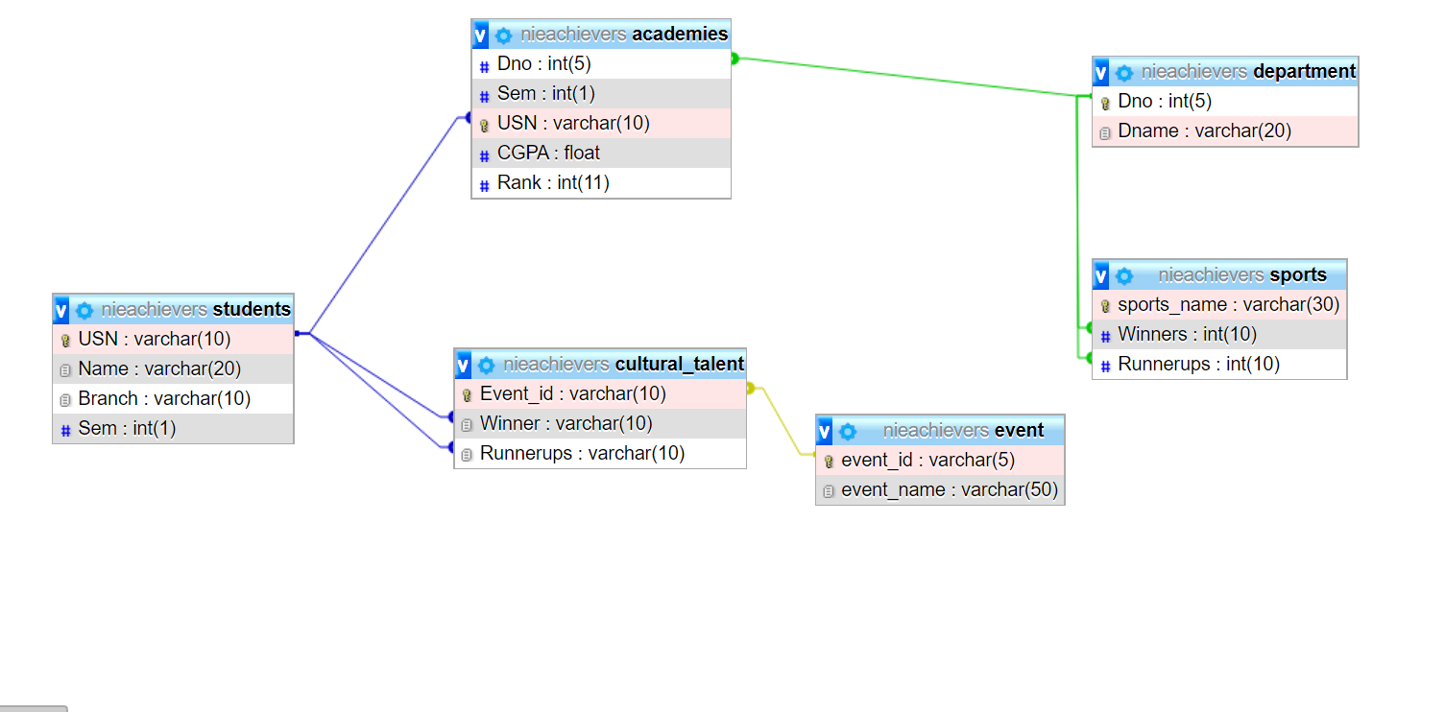
Schema Diagram

Slide 18
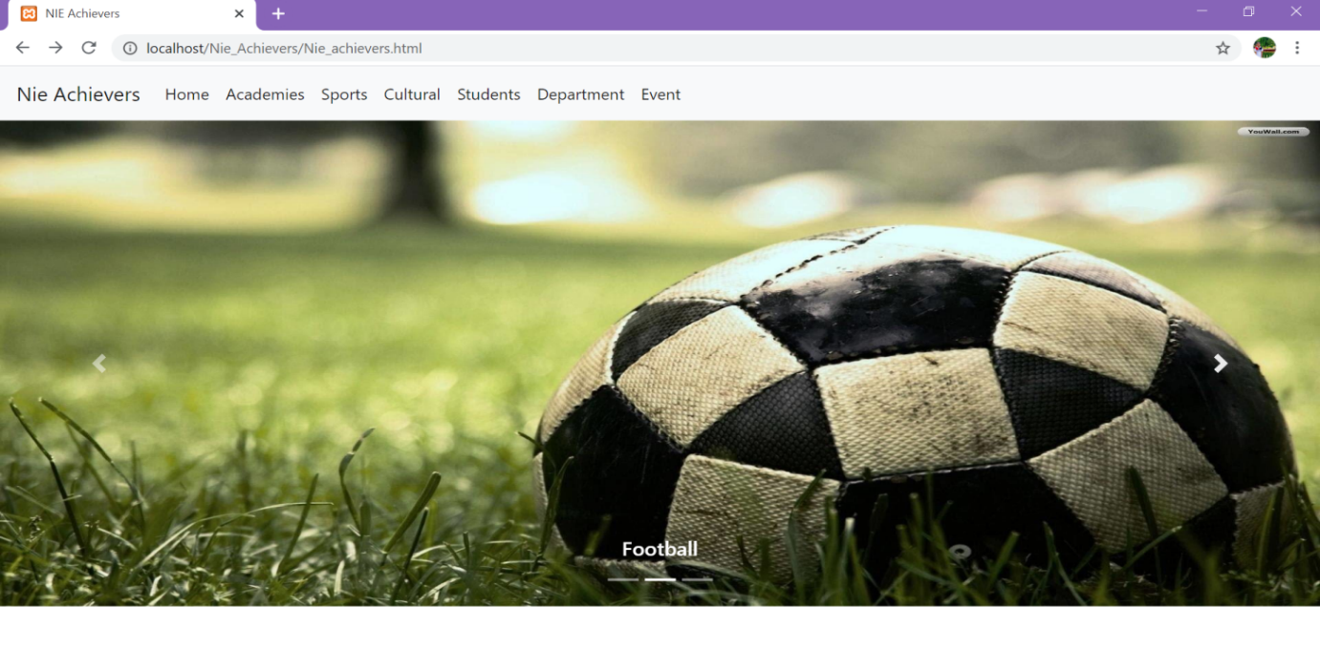
Snapshots
This is the web interface of our database project.

Slide 19
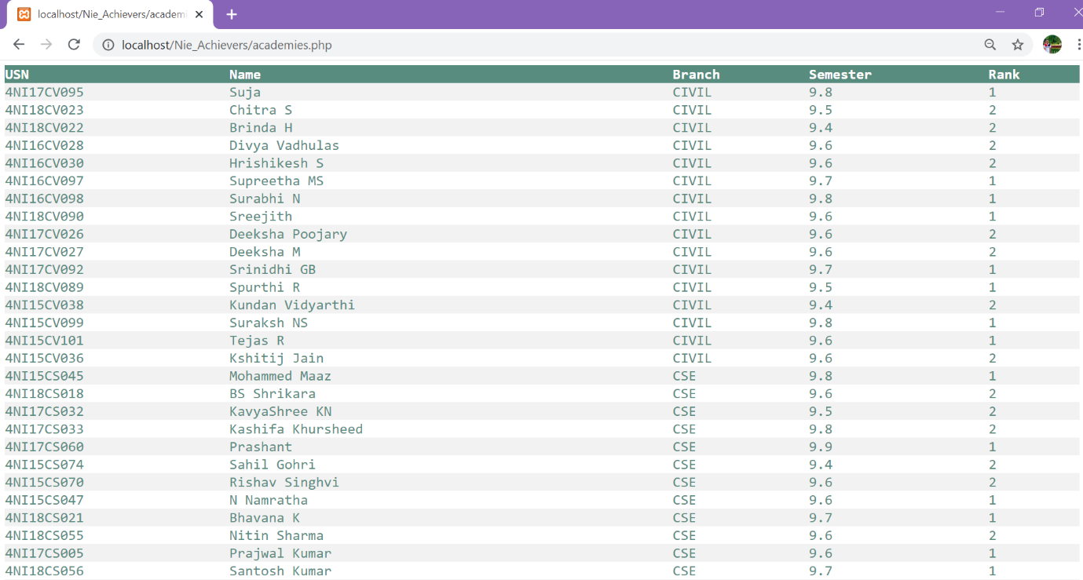
This is the academies details of the students.
Query is "SELECT s.USN, s.Name, s.Branch, a.CGPA, a.Rank FROM students s,academies a where s.USN = a.USN order by Branch";

Slide 20
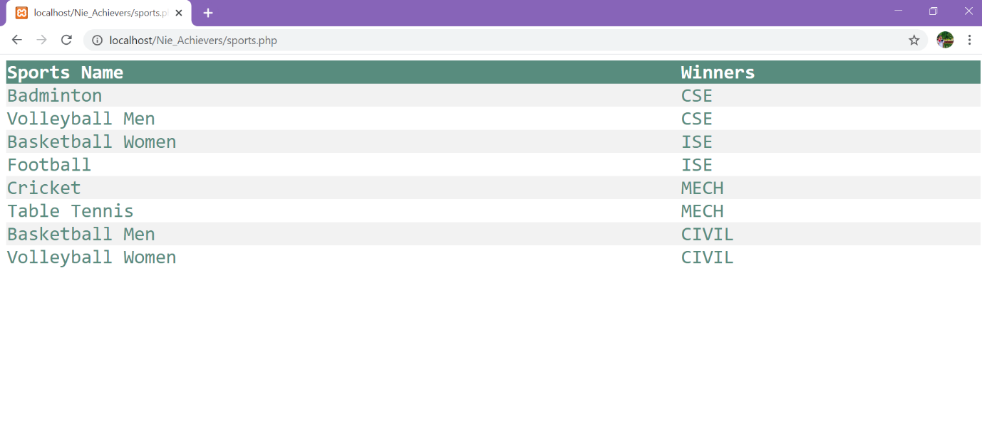
This table has the list of winning departments in various sports.
Query is "Select sp.sports_name,d.Dname from sports sp, department d where d.Dno = sp.Winners;"

Slide 21
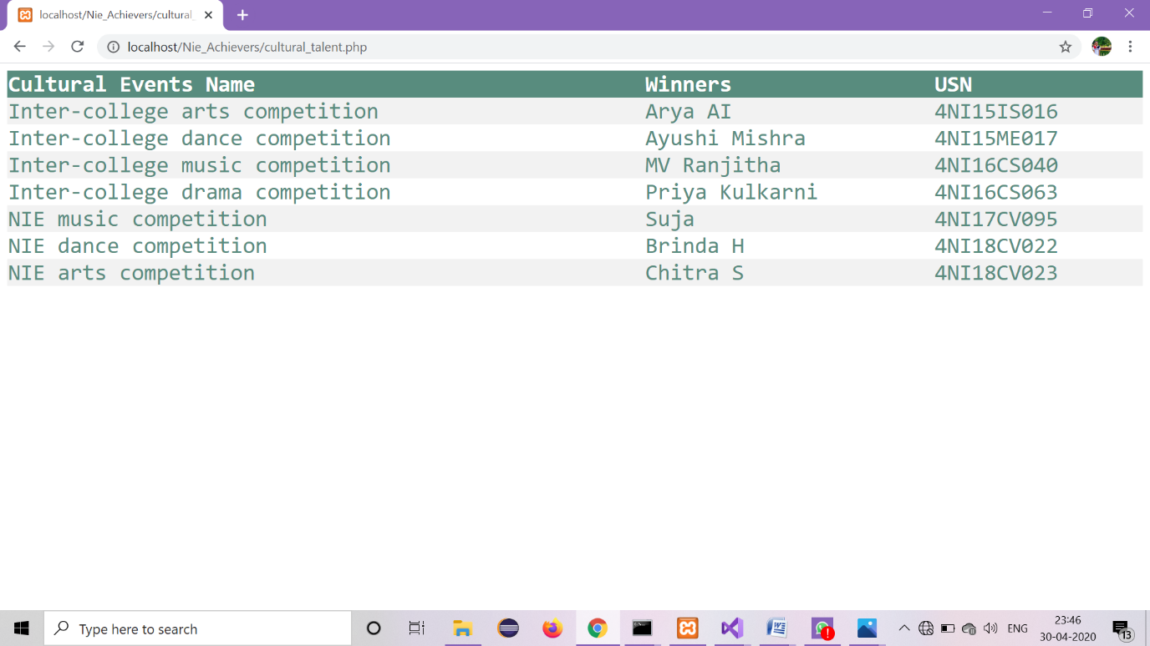
This table has the list of participants who won different cultural Events.
Query is "Select e.event_name, s.name, s.USN from students s,event e,cultural_talent c where e.event_id = c.event_id and s.usn = c.winner ;"

Slide 22
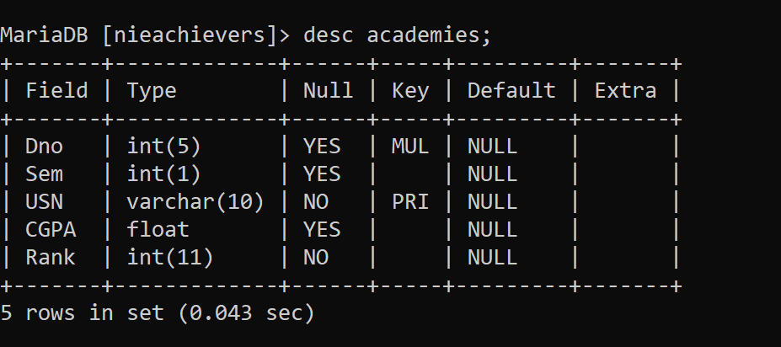
Implementation
To create table academies:
CREATE TABLE academies (Dno int(5), Sem int(1),USN varchar(10) PRIMARY KEY,CGPA float,Rank int(11),FOREIGN KEY(Dno) references department(Dno));
To display academies table:

Slide 23
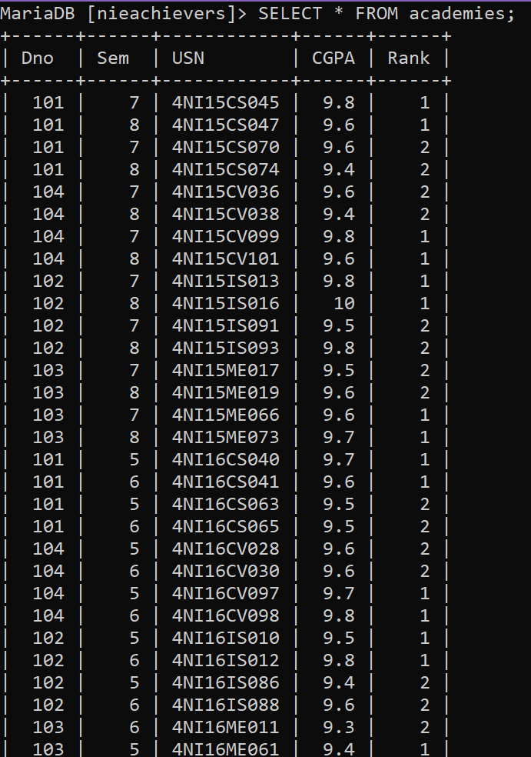
To display values of academies

Slide 24
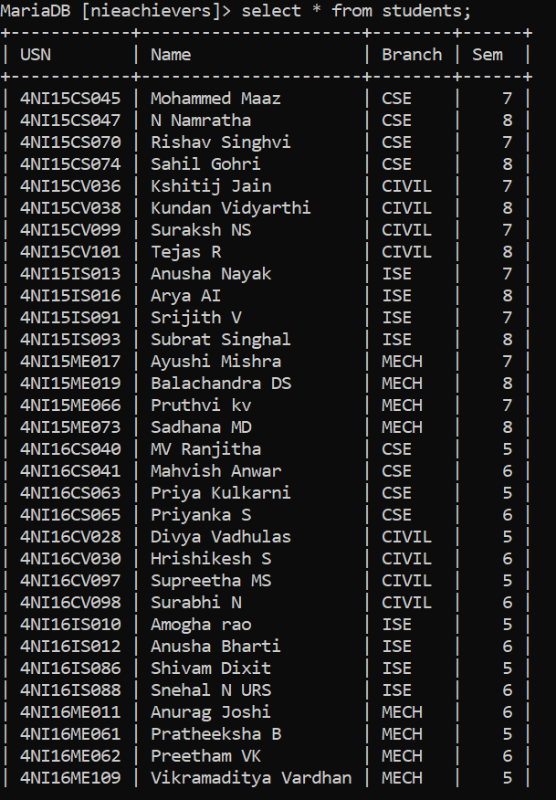
To display values of students

Slide 25
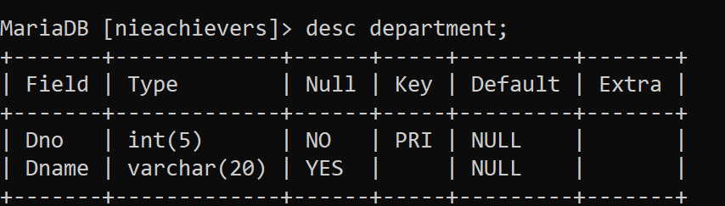
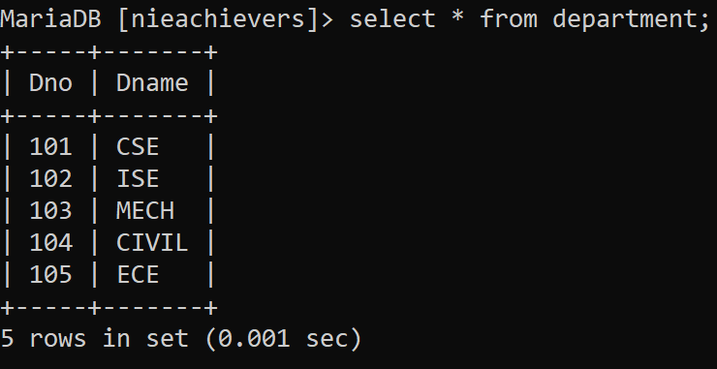
To create table department:
CREATE TABLE department (Dno int(5) PRIMARY KEY ,Dname varchar(20));
To display table department
To display values of department

Slide 26
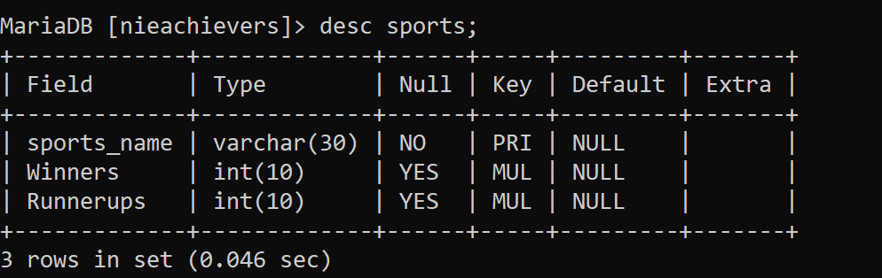
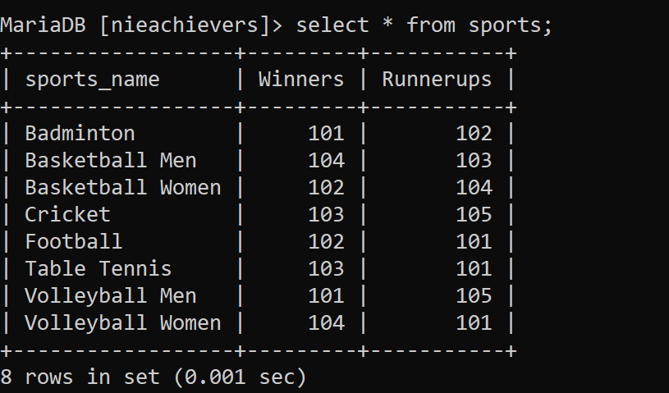
To create table sports:
CREATE TABLE sports (sports_name varchar(30) PRIMARY KEY, Winners int(10), Runnerups int(10),FOREIGN KEY(Winners) references department(Dno), FOREIGN KEY(Runnerups) references department(Dno));
To display sports table:
To display values of sports

Slide 27
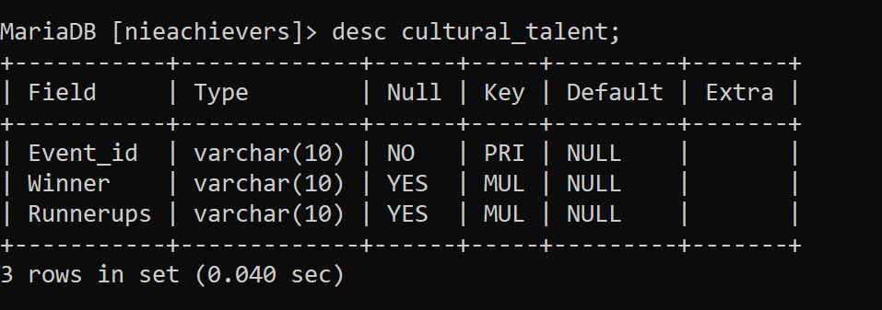
To create table cultural_talent:
CREATE TABLE cultural_talent (Event_id varchar (10) PRIMARYKEY, Winner varchar(10), Runnerups varchar(10) ,FOREIGN KEY (Event_id) referencesevent (event_id),FOREIGN KEY (Winner) references students(USN),FOREIGN KEY (Runnerups) references students(USN));
To display table cultural_talent:

Slide 28
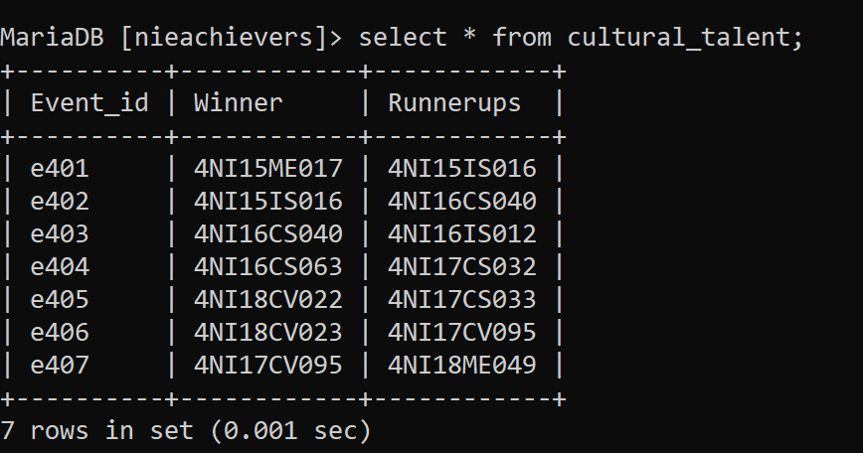
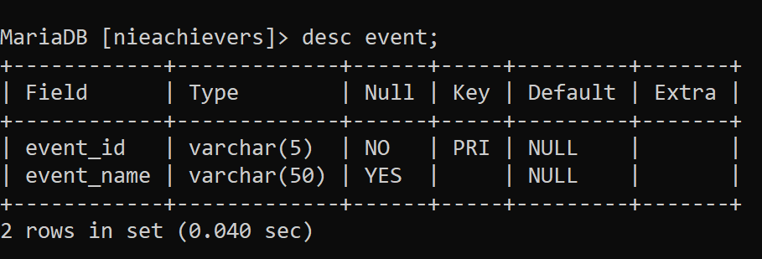
To display values of cultural_talent
To create table event:
CREATE TABLE event (event_id varchar (5) PRIMARY KEY, event_name varchar (50));
To display event table:

Slide 29
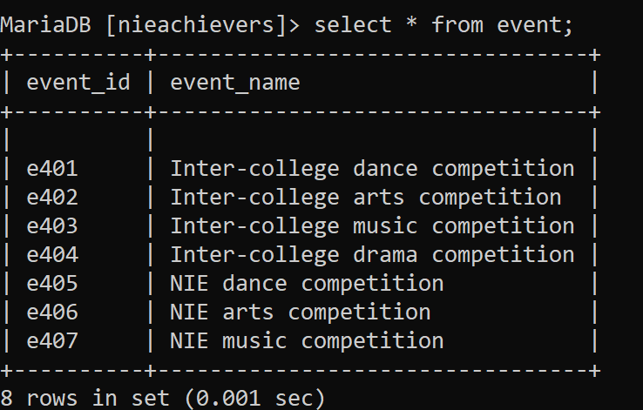
To display value of event

Slide 30
CONCLUSION AND FUTURE ENHACEMENTS
The purpose of the webpage was to create a platform for the management of the institution where student achiever’s information who have received awards and recognition in various fields like academics, sports, art, dance, music and many more are recorded in the database. This helps the faculty members get the information immediately and quickly whenever they need it. With this webpage, we give the management department of the institution a platform to maintain a student database, and keep a track of allthe eventsand the achievements of the students at one platform instead of maintaining separate data for all events.
We have strived to achieve most of the goals that we had planned at the beginning of this project.
Future enhancements may include further functionality such as email notifications for the students at the end of the academic year inviting them to the award ceremony during the graduation day or any such award distribution event. Also, the facility to add on more events like technical papers presented by students in recognizable platforms, achievements of the clubs of the institution and such appreciable events.

Slide 31
THANK YOU

